Slide 1
Displaying Energy Transformations

Slide 2
By the end of this lesson, you should be able to do the following:
Describe the energy transformations involved in making hydroelectricity.
Explain what energy flowcharts are and how we use them.

Slide 3
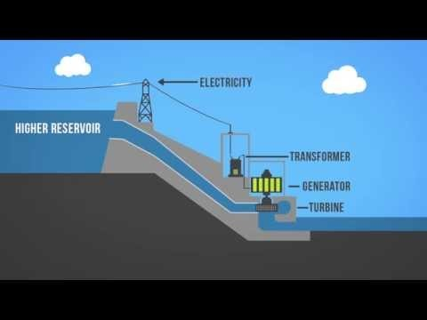
The following video (2:00) helps to explain how hydroelectric dams work:

Slide 4
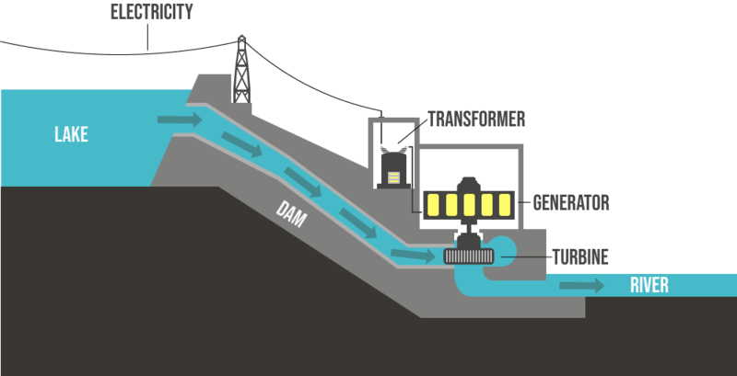
The water in a reservoir behind a hydropower dam is an example of potential energy.
The gravitational potential energy in the reservoir is converted into kinetic energy as the water flows down a large pipe called a penstock and spins a turbine.

Slide 5

The turbines spin a shaft inside the generators, which transform the kinetic energy into electrical energy. This electrical energy is then sent through power lines to consumers!
We can construct an energy flowchart which shows the energy transformation in a hydro dam.

Slide 6
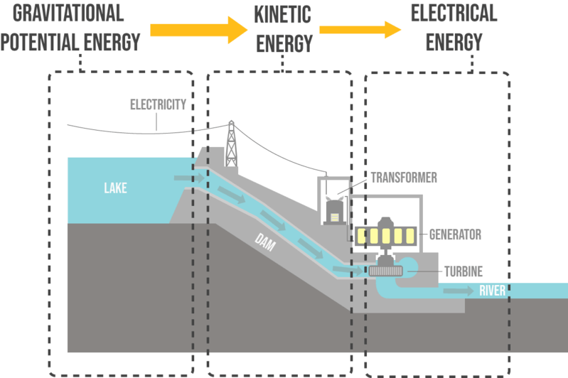
The arrows get smaller as you go along the diagram. This is because some energy is wasted so there is less useful energy being transformed.
The arrows always point in the direction that energy flows in.

